Slide 1
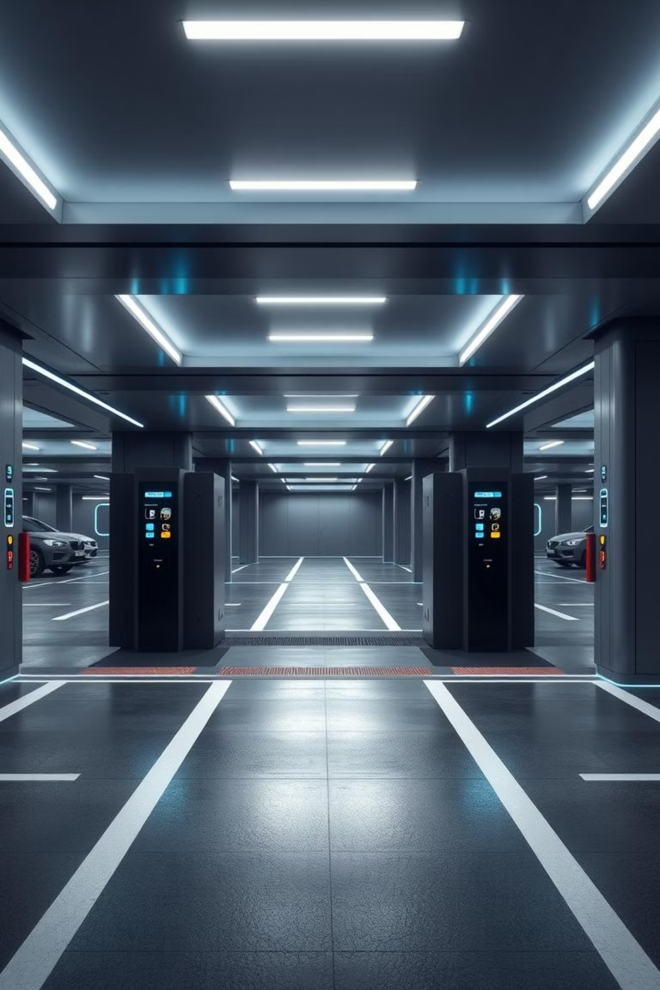
Parking Management System
Smart and Efficient Vehicle Parking Solution
Presented by: Yash Chavan, Gaurav Salunke, Aaditi Bais

Slide 2

Introduction to Smart Parking
A Parking Management System (PMS) leverages technology to optimize parking space utilization and enhance user experience. This project aims to streamline parking operations, reduce congestion, and provide a secure, digital solution for vehicle parking in urban environments.

Slide 3

Addressing Critical Parking Challenges
Urban areas face significant parking issues, leading to frustration and economic loss. Our system targets these core problems:
Congestion & Time Waste
Manual Ticketing Inefficiencies
Space Unavailability
Drivers spend excessive time searching for available parking spots.
Lack of real-time information on open parking slots exacerbates the problem.
Error-prone and slow manual processes lead to delays and disputes.

Slide 4



Project Objectives: Enhancing Parking Efficiency
Our primary objectives are to revolutionize parking management by integrating automation and digital security.
Reduce Manual Effort
Track Slot Availability
Secure Digital Ticketing
Automate entry, exit, and payment processes, minimizing human intervention.
Provide real-time updates on vacant and occupied parking spaces.
Implement a robust, digital ticketing system for enhanced security and convenience.

Slide 5

System Architecture Overview
The Parking Management System comprises interconnected modules ensuring seamless operation and data flow.
Entry/Exit Sensor
Detect vehicle movements at gates
Database
Store and manage parking data
Admin Panel
Control and monitor system settings
User Interface
Provide user access and info
Entry/Exit Sensor: Detects vehicle presence and movement.
Database: Stores real-time parking data, user information, and transaction records.
Admin Panel: Centralized control for system management and reporting.
User Interface: Provides an intuitive platform for drivers to find and reserve parking.

Slide 6




Robust Technology Stack
Our system is built on a reliable and widely-adopted technology stack, ensuring stability and scalability.
Core Technologies
Development Tools
Languages: Java
IDE: IntelliJ IDEA for efficient code development.
Backend: JDBC for database connectivity with MySQL.
Server Environment: XAMPP for local server setup and database management.
GUI: Java Swing / JavaFX for rich user interfaces.

Slide 7
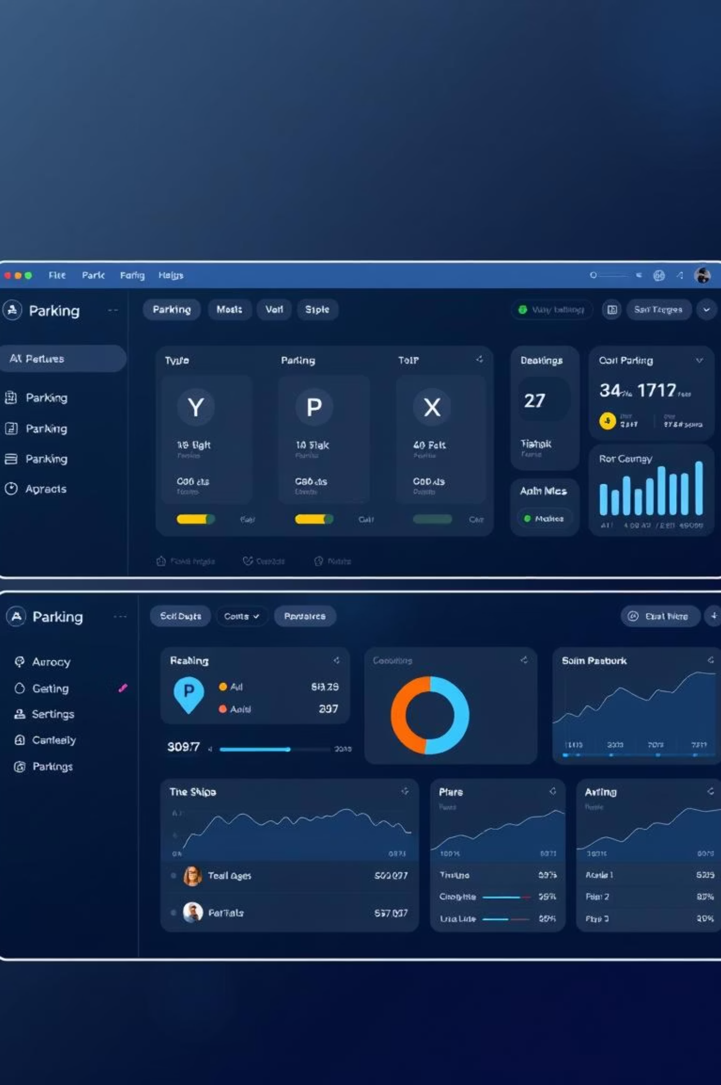





Key Features and Implementation
The system offers a suite of features designed for both users and administrators to ensure efficient parking operations.
Real-time Slot Tracking
Dynamic updates on parking availability, visible to users.
User Authentication
Secure login and profile management for registered users.
Admin Dashboard
Comprehensive overview of parking lot status, revenue, and user activity.
Automated Timestamps
Accurate recording of vehicle entry and exit times for billing and security.

Slide 8
Conclusion & Future Enhancements
The Parking Management System offers a comprehensive solution to urban parking challenges, laying the groundwork for future innovations.
Summary of Benefits
Future Enhancements
Enhanced user convenience and reduced search time.
RFID Integration: For faster, automated vehicle identification.
Optimized parking space utilization.
Improved security and digital record-keeping.
Mobile App Support: Real-time booking and navigation via smartphone.
Reduced operational costs for parking facilities.
Dynamic Pricing: Adjusting rates based on demand and availability.
EV Charging Integration: Managing and monitoring electric vehicle charging spots.
Thank you for your time. We welcome any questions.

